Slide 1
Thread Packages
Lars Ailo Bongo (larsab@cs.uit.no) University of Tromsø Spring 2019

Slide 2
Acknowledgements
Includes slides made by Tore Larsen, which in turned based these on slides from O. Anshus, T. Plagemann, C. Griwodz, M. van Steen, and A. Tanenbaum
Also includes figures from Modern Operating System by A. Tanenbaum
In addition multiple other references as stated in the slides

Slide 3
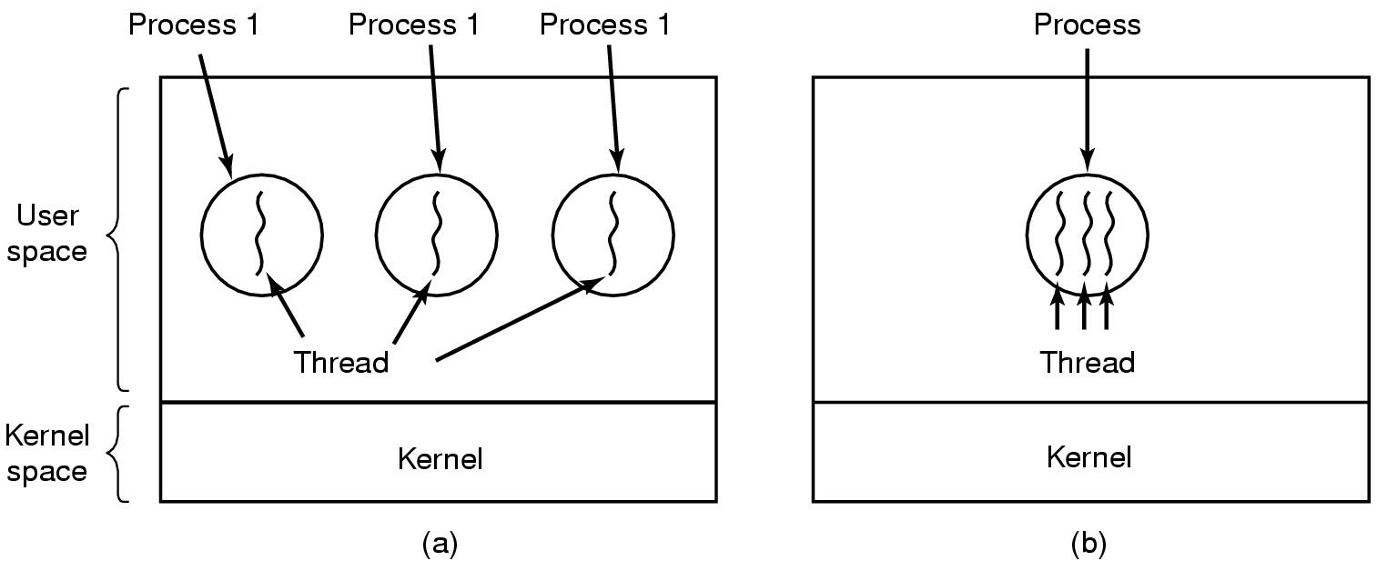
Threads The Thread Model (1)
(a) Three processes with one thread each
(b) One process with three threads
Notes:
Processes were invented as single thread entities
Parallelism between processes
Offers protection
Which makes (single threaded) processes inefficient as a means for many threads working together on same task
Multiple threads within single processes offer the potential of efficient cooperation between threads working in parallel
We assume threads within same process all are “friendly” and want to work together.
Process still offers protection between threads in different processes.
“Lightweight processes” was a term that is descriptive of what one wanted. But possibly misleading as to what threads actually are.
So, how “light” should a thread be? What information should we keep per thread, and what per process?
Need: Switching between threads as we already do for processes.
Program pointer, obviously. Stack for procedure calls/returns, obviously. Registers, seems reasonable. Process state, i.e. blocked, ready, running, terminated; for thread scheduling purposes.

Slide 4
The Thread Model (2)
Per process items | Per thread items
Address space | Program counter
Global variables | Registers
Open files | Stack
Child processes | State
Privileges
Pending alarms
Signals and signal handlers
Accounting information
Items shared by all threads in a process | Items private to each thread
Notes:
Make a note that it is appropriate to have semaphores, mutexes and condition variables as global variables, or at least at a well-known place in the shared address space (dynamic memory -> later).
Important to have them – memory allocation example.

Slide 5
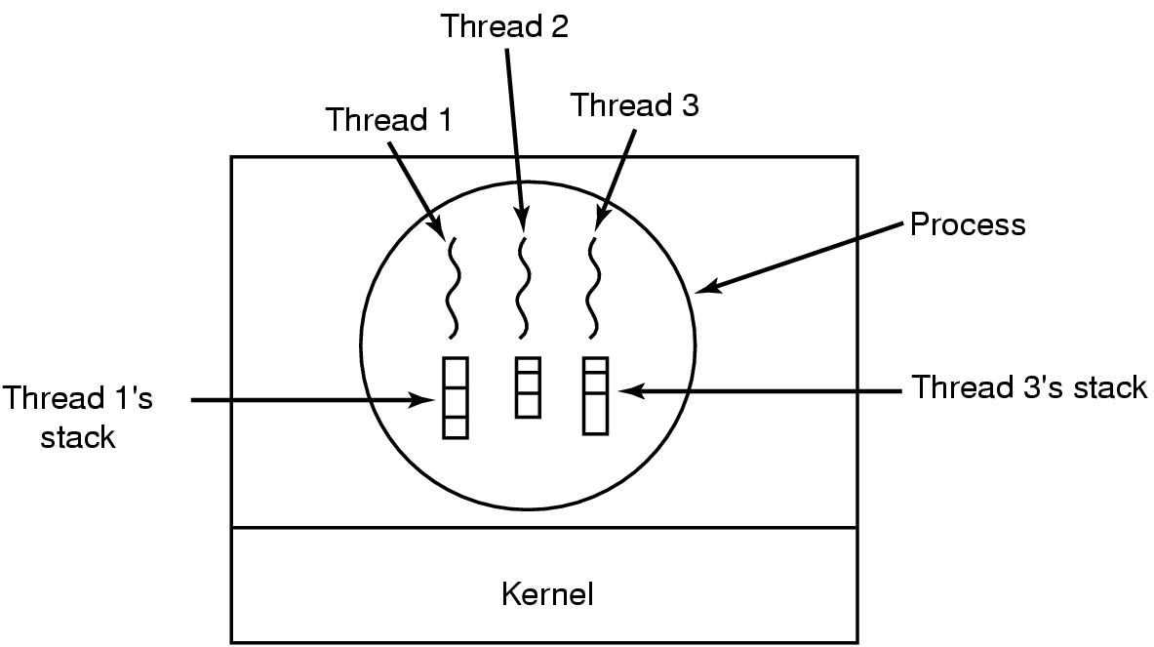
The Thread Model (3)
Each thread has its own stack
Notes:
Each thread has it’s own stack.
Also, we need to be able to store PC, register values, PC, and thread state, per thread.

Slide 6
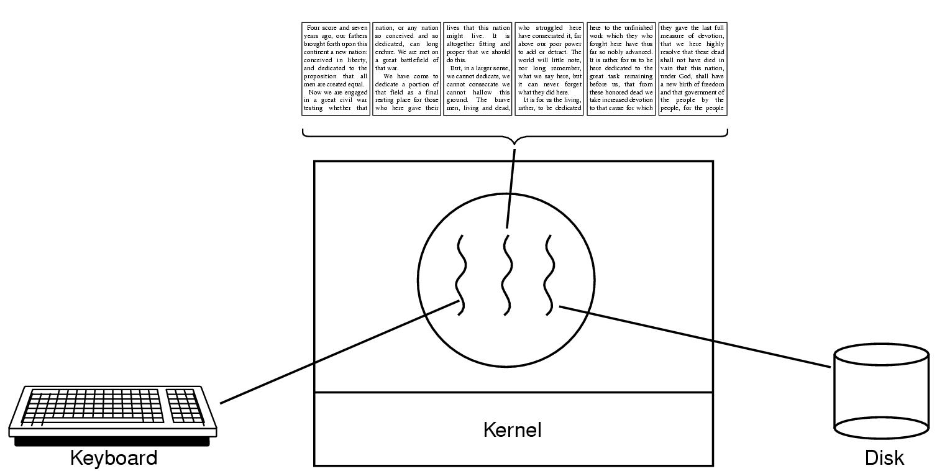
Thread Usage (1)
A word processor with three threads
Notes:
Why would we use multiple threads?
a) As a means of organizing our solution:
In this example (document editing), separate threads for user interaction, formatting, and intermediate saving
b) Performance
Creation/destruction of threads cheaper than for processes
Overlapping operations
c) Resource utilization (variant of performance)
Current off-the-shelf computer processors are combinations of
Multithreaded – (Intel uses different term) Multiple concurrent threads executed per core
Multicore – multiple processor cores per chip/system
Other?

Slide 7
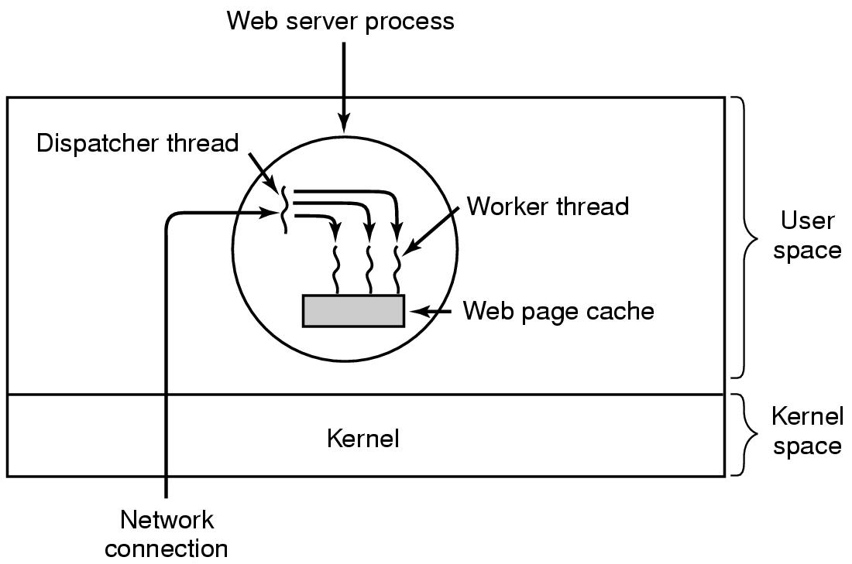
Thread Usage (2)
A multithreaded Web server
Notes:
Special here: must answer events that take long time to process
Draw the thread pool situation
Explain thread creation if faster than process creation – waking threads is even faster

Slide 8
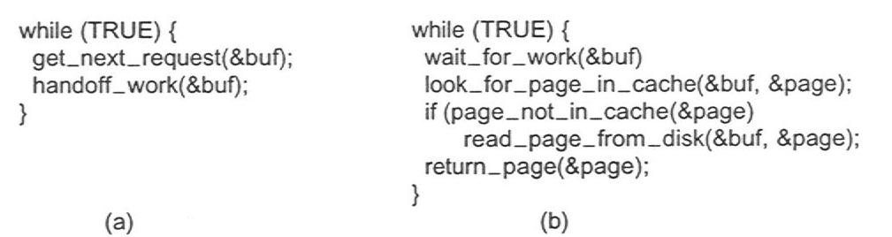
Thread Usage (3)
Rough outline of code for previous slide
(a) Dispatcher thread
(b) Worker thread

Slide 9
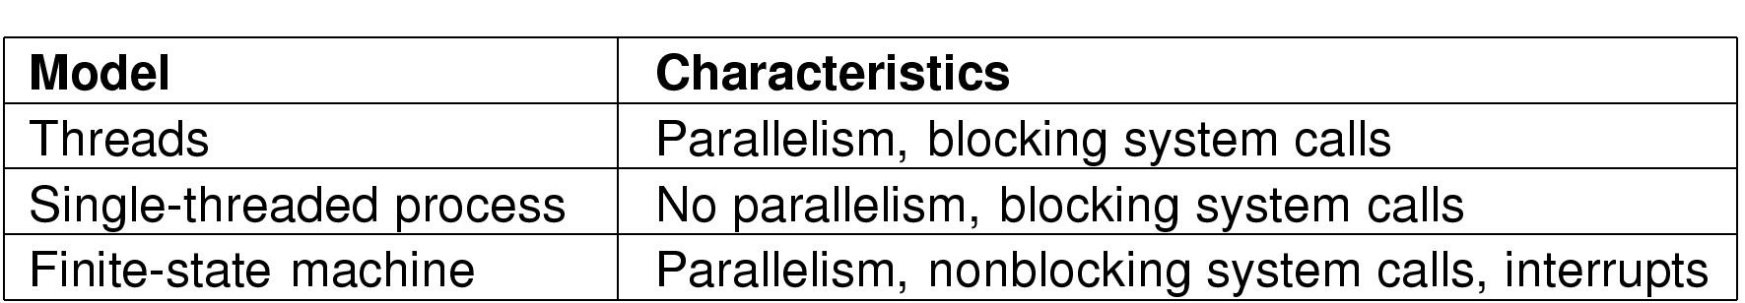
Thread Usage (4)
Three ways to construct a server
Notes:
Do students know what a finite state machine is?
State transition diagram?
If not, can illustrate using branch prediction:
Simple predictor: “Weather tomorrow will be same as today.” Guess that the branch goes the same way (taken/not-taken) as in it’s previous execution. Two states, four state transitions.
One better: Don’t be so quick to change our prediction. Look at weather for two previous days. Add two new states, one at each “end” of the previous diagram, go away from the taken/not-taken transition in either direction after two consecutive correct prediction. Get back towards the taken/not-taken transition on one wrong guess. If the next guess also is wrong, we change our prediction. If it is right, we redraw again.
What would this mean in web server example? What are the states and the transitions?
Require non-blocking call or select.
Draw FSM idea?
Finite-state machine approach is a concept, it does not mean that an actual FSM language and compiler is used.

Slide 10











Pthreads

Slide 11
Outline (reverse order)
Programming languages
Java
Pthreads
HTML5 (JavaScript)
Thread libraries
Pthreads
OpenMP
Operating system threads
Design choices
Linux
Windows
Hardware support
Simultaneous multi-threading

Slide 12
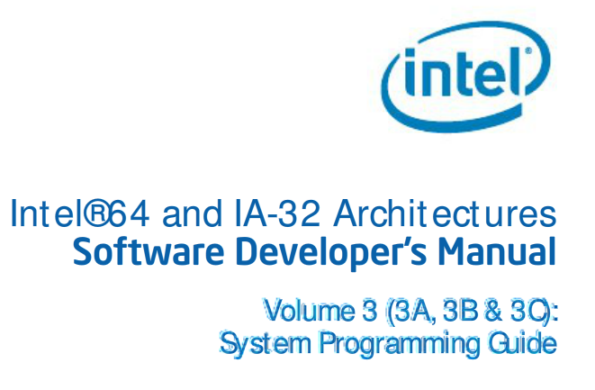
Hardware Support for Threading

Slide 13
Hardware Support for Threading
The Intel 64 and IA-32 architectures provide mechanisms for managing and improving the performance of multiple processors connected to the same system bus. These include:
Bus locking and/or cache coherency management for performing atomic operations on system memory.
Serializing instructions. […]
An advance programmable interrupt controller (APIC) located on the processor chip […]
A second-level cache (level 2, L2). […]
A third-level cache (level 3, L3). […]
Intel Hyper-Threading Technology. This extension to the Intel 64 and IA-32 architectures enables a single processor core to execute two or more threads concurrently […]

Slide 14
Hardware Support for Threading (2)
These mechanisms are particularly useful in symmetric-multiprocessing (SMP) systems. However, they can also be used when an Intel 64 or IA-32 processor and a special-purpose processor (such as a communications, graphics, or video processor) share the system bus.
These multiprocessing mechanisms have the following characteristics:
To maintain system memory coherency — When two or more processors are attempting simultaneously to access the same address in system memory, some communication mechanism or memory access protocol must be available to promote data coherency and, in some instances, to allow one processor to temporarily lock a memory location.
To maintain cache consistency — When one processor accesses data cached on another processor, it must not receive incorrect data. If it modifies data, all other processors that access that data must receive the modified data.

Slide 15
Hardware Support for Threading(3)
To allow predictable ordering of writes to memory — In some circumstances, it is important that memory writes be observed externally in precisely the same order as programmed.
To distribute interrupt handling among a group of processors — When several processors are operating in a system in parallel, it is useful to have a centralized mechanism for receiving interrupts and distributing them to available processors for servicing.
To increase system performance by exploiting the multi-threaded and multiprocess nature of contemporary operating systems and applications.

Slide 16
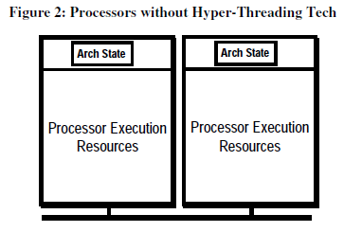
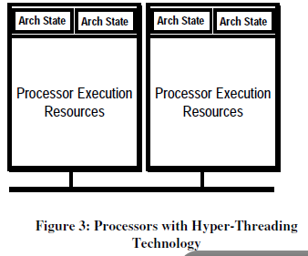
Simultaneous Multi-threading (SMT)
Multi-core vs. multi-threaded CPU?
Both allows running multiple threads in parallel
Multi-core: multiple full cores on a chip
Multi-threaded: some CPU resources are shared between threads
Multi-threaded: a thread is “context switched” when blocked on long latency events (cache misses or memory reads)
Figures from Intel Technology Journal Vol 06, Issue 01, Feb. 2002

Slide 17
Hardware support
Is that it?
Does other platforms provide additional support?

Slide 18
Outline (reverse order)
Programming languages
Java
Pthreads
HTML5 (JavaScript)
Thread libraries
Pthreads
OpenMP
Operating system threads
Design choices
Linux
Windows
Hardware support
Simultaneous multi-threading

Slide 19
Implementation of Thread Packages
Two main approaches to support threads
In user space
In kernel space
Run-time system
Kernel
Kernel
User-level thread package
Thread package managed by the kernel
Notes:
At the left, run-time system per process

Slide 20
Implementation of Thread Packages
Two main approaches to implement threads
In user space
In kernel space
Hybrid solutions: cooperation between user level and kernel
Scheduler activation
Pop-up threads
Run-time system
Kernel
Kernel
User-level thread package
Thread package managed by the kernel

Slide 21
Implementation of Threads
Run-time system
Kernel
Kernel
User-level thread package
Thread package managed by the kernel
User level
If a thread blocks in a system call, user process blocks
Can have a wrapper around syscalls preventing process block
Kernel level
Support for one single CPU per process
User level
If a thread blocks in a system call, user process does not
Can schedule threads independently
Kernel level
Support for multiple CPUs per process

Slide 22
User Level Thread Packages
Implementing threads in user space
Kernel knows nothing about them, it is managing single-threaded applications
Threads are switched by runtime system, which is much faster than trapping the kernel
Each process can use its own customized scheduling algorithm
Blocking system calls in one thread block all threads of the process (either prohibit blocking calls or write jackets around library calls)
A page fault in one thread will block all threads of the process
No clock interrupts can force a thread to give up CPU, spin locks cannot be used
Designed for applications where threads make frequent system calls

Slide 23
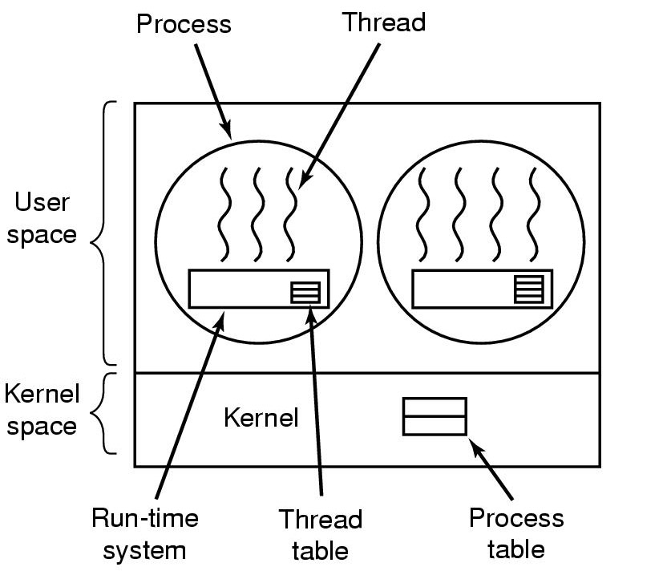
Implementing Threads in User Space
A user-level thread package

Slide 24
User Level Thread Packages
Implementation options
Libraries
Basic system libraries (“invisible”)
Additional system libraries
Additional user libraries
Language feature
Java (1.0 – 1.2 with “green threads”)
ADA
Go
…

Slide 25
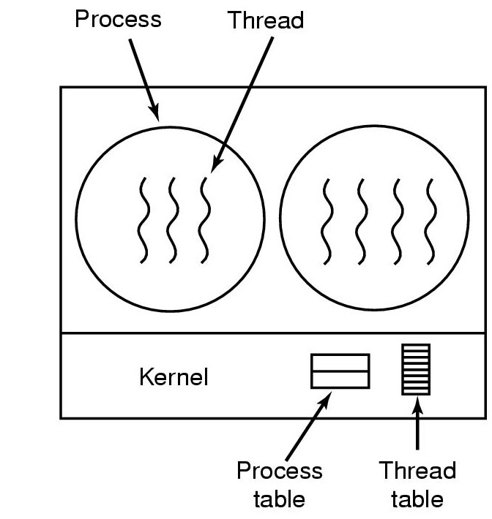
Implementing Threads in the Kernel
A threads package managed by the kernel

Slide 26
Kernel Level Thread Packages
Implementing threads in the kernel
When a thread wants to create a new thread or destroy an existing thread, it makes a kernel call, which then does the creation or destruction (possibly optimizing by recycling threads)
Kernel holds one table per process with one entry per thread
Kernel does scheduling, clock interrupts available, blocking calls and page faults no problem
Performance of thread management in kernel is lower

Slide 27
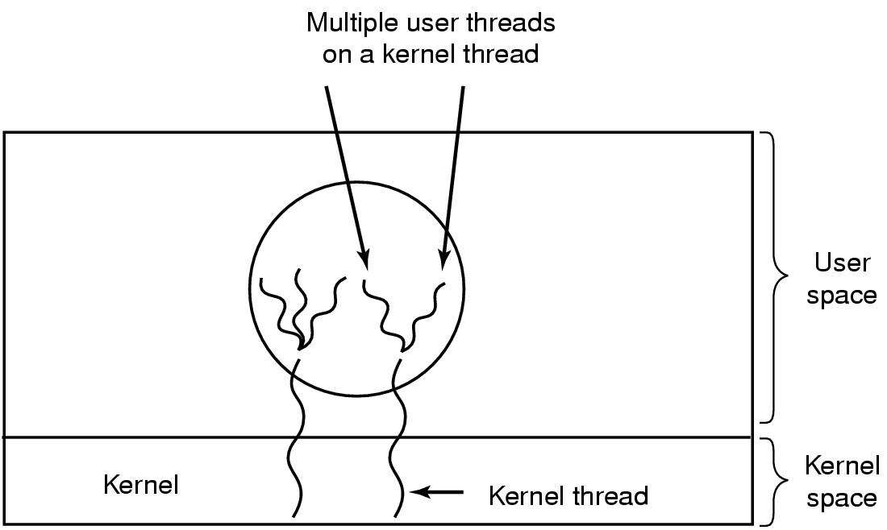
Hybrid Implementations
Multiplexing user-level threads onto kernel- level threads
Notes:
M:N thread model
En tanke er at flere traader enn CPUer I systemet er ikke effisient. Derfor bruk kjernetraader bare opp til CPU-antall. Veldig vanskelig aa implementere fordi traader som blokkerer skal ikke blokkere en CPU – kooperasjon mellom user space og kernel trenges.

Slide 28
Scheduler Activations
Scheduler activation
Goals: combine advantages of kernel space implementation with performance of user space implementations
Avoid unnecessary transitions between user and kernel space, e.g., to handle local semaphore
Kernel assigns virtual processors to each process and runtime system allocates threads to processors
The kernel informs the process’s runtime system via an upcall when one of its blocked threads becomes runnable again
Runtime system can schedule
Runtime system has to keep track when threads are in or are not in critical regions
Upcalls violate the layering principle

Slide 29
User-level threads on top of Scheduler Activations
User-level threads
blocked
active
User-level scheduling
user
kernel
Scheduler activation
blocked
active
Kernel-level scheduling
Physical processor

Slide 30
Scheduler Activations - I
User program
(1)
(2)
(1)
(2)
(3)
(4)
User-level
Runtime
System
Ready list
(A)
(B)
OS Kernel
add processor
add processor

Slide 31
Scheduler Activations - II
User program
(1)
(2)
(3)
(3)
(4)
User-level
Runtime
System
Blocking I/O
Ready list
(A)
(B)
(C)
OS Kernel
A’s thread has blocked

Slide 32
Scheduler Activations - III
User program
(1)
(2)
(3)
(1)
(4)
(2)
User-level
Runtime
System
Ready list
(A)
(B)
(C)
(D)
OS Kernel
I/O Completed
A’s thread and B’s thread can continue

Slide 33
Scheduler Activations - IV
User program
(3)
(1)
(4)
(2)
User-level
Runtime
System
Ready list
(C)
(D)
OS Kernel

Slide 34
Scheduler Activations in NetBSD
Nathan J. Williams: ”An Implementation of Scheduler Activations on the NetBSD Operating Systems”, in Proceedings of Freenix/Usenix 2002
CVS branch nathanw_sa; integration into NetBSD-current in 2003
Earlier implementations of scheduler activations in Taos, Mach 3.0, BSD/OS, Digital Unix (now Compaq Tru64 Unix)

Slide 35
Kernel Interface - I
Application → scheduler activation system, i.e., by system calls:
sa_register( )
sa_setconcurrency( )
sa_enable( )
sa_yield ( )
sa_preempt( )
Scheduler activation → application, i.e., by upcall:
void sa_upcall(int type, struct sa_t *sas[], int events, int interrupted, void *arg);

Slide 36
Kernel Interface - II
Events that generated upcalls:
SA_UPCALL_NEWPROC
SA_UPCALL_PREEMPTED
SA_UPCALL_BLOCKED
SA_UPCALL_UNBLOCKED
SA_UPCALL_SIGNAL
SA_UPCALL_USER
Low level upcall mechanism is similar to signal delivery

Slide 37
Kernel Interface - III
Stacks:
Any upcall code needs to store local variables, return address, etc.
Using stack of preempted thread?
New processor allocations
Makes thread management more difficult
Each upcall got its own stack
System call sa_stack( )
Signals:
Support the POSIX signal model
Kernel does not know about specific threads
Signals are handed to the application with an upcall

Slide 38
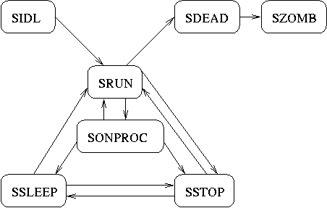
Kernel Implementation - I
NetBSD kernel has a monolithic process structure including execution context
First task: separation of process context from execution context
Old NetBSD process states

Slide 39
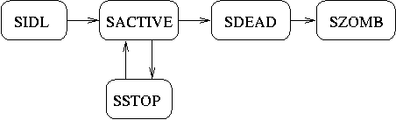
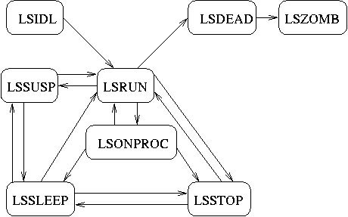
Kernel Implementation - II
New process states
New LWP states

Slide 40
Kernel Implementation - III
NetBSD manages all process data in struct proc
Move all execution related data into a new struct lwp
Update all code parts with variables of type struct proc
Scheduler must handle LWPs instead of processes
Change fork( )to create new LWPs for new processes

Slide 41
Thread Implementation
Goal: become the supported POSIX compatible library for NetBSD
Scheduler activations can always be preempted
Violation of atomicity of critical sections of code
Example maintenance of ru queue in thread library
Normally spin lock are used
Upcall handler might try to get the same lock
Deadlock (we discuss this later in more detail!)

Slide 42
Some Performance Numbers
HBench-OS on 500 MHz Digital Alpha 21164 system
Apple iBook 500 MHz G3 CPU 256 L2 cache
 | before SA | after SA
getpid | 0.631 | 0.601
getrusage | 4.053 | 4.332
timeofday | 1.627 | 1.911
sbrk | 0.722 | 0.687
sigaction | 1.345 | 1.315
 | SA | PTH | Linux
Thread | 15 μs | 96 μs | 90 μs
Mutex | 0.4 μs | 0.3 μs | 0.6 μs
Context | 225 μs | 166 μs | 82 μs

Slide 43
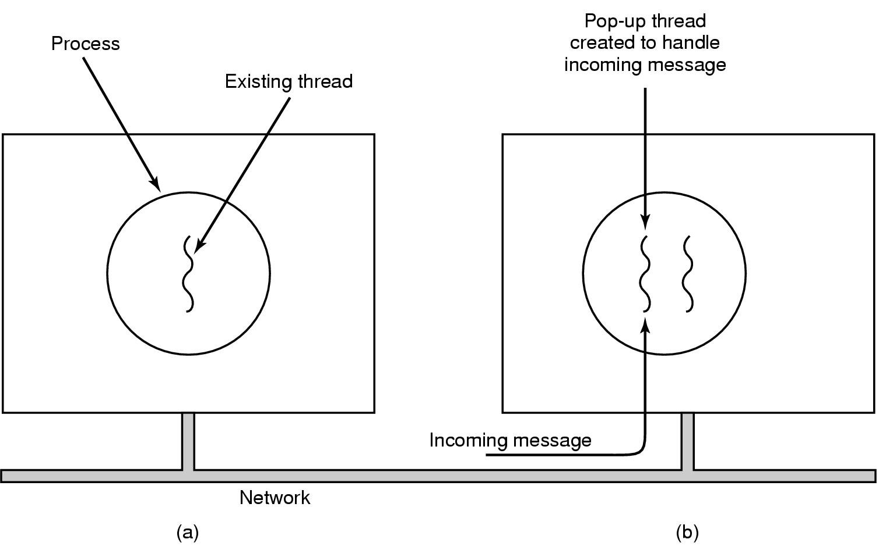
Pop-Up Threads
Creation of a new thread when message arrives
(a) before message arrives
(b) after message arrives
Notes:
OS/2 eksempel: vi hadde langsomme maskiner som skulle prosessere multimedia stroem pakker i sanntid. Derfor skulle kjerne traader (OS/2 hadde de) haandtere pakker hele veien fra nettverkskortet inn i user space opp til A/V dekoderen.

Slide 44
Pop-Up Threads
Fast reacting to external events possible
Packet processing is meant to last a short time
Packets may arrive frequently
Questions with pop-up threads
How to guarantee processing order without loosing efficiency?
How to manage time slices? (process accounting)
How do schedule these threads efficiently?

Slide 45
Existing Thread Packages
All have
Thread creation and destruction
Switching between threads
All specify mutual exclusion mechanisms
Semaphores, mutexes, condition variables, monitors
Why do they belong together?
Notes:
Bring Ultimedia Server example. A nice fake of a thread package, POSIX compatible API.
Not a true thread package – why?
Resources did not belong to any process, no clean-up possible!

Slide 46
Some existing thread packages
POSIX Pthreads (IEEE 1003.1c) for all/most platforms
Some implementations may be user level, kernel level or hybrid
GNU PTH
Linux
JAVA for all platforms
User level, but can use OS time slicing
Win32 for Win95/98 and NT
kernel level thread package
OS/2
kernel level
Basic idea in most packages
Simplicity, fancy functions can be built using simpler ones

Slide 47
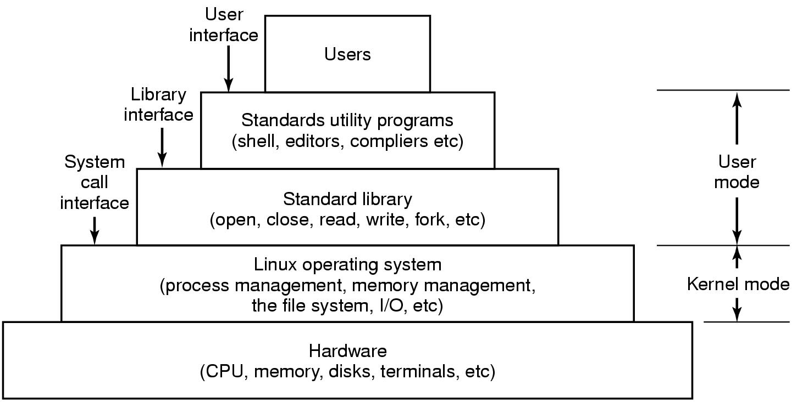
Interfaces to Linux
Figure 10-1. The layers in a Linux system.
Tanenbaum, Modern Operating Systems 3 e, (c) 2008 Prentice-Hall, Inc. All rights reserved. 0-13-6006639

Slide 48
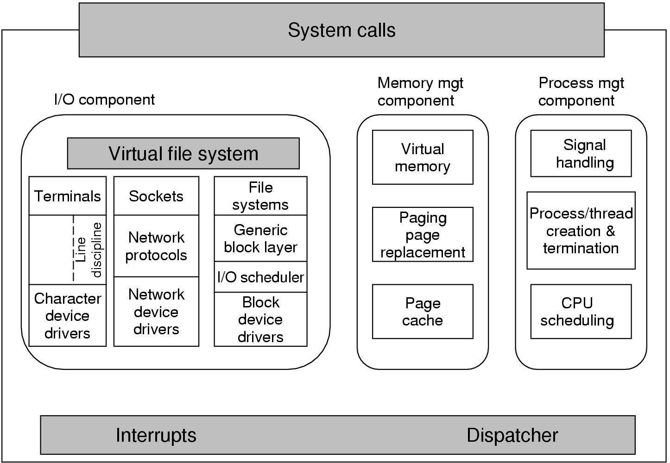
Kernel Structure
Figure 10-3. Structure of the Linux kernel
Tanenbaum, Modern Operating Systems 3 e, (c) 2008 Prentice-Hall, Inc. All rights reserved. 0-13-6006639

Slide 49
The Thread Model (recap)
Notes:
Each thread has it’s own stack.
Also, we need to be able to store PC, register values, PC, and thread state, per thread.

Slide 50
Linux Process/ Threads
Linux takes a unique approach to implementing the process and thread abstractions. In Linux, all threads are simply processes that might share certain resources. Instead of being something different than a thread or a group of threads, a process in Linux is simply a group of threads that share something called a thread group ID (TGID) and whatever resources are necessary.
It is worth mentioning that this model, combined with certain tricks like a COW (Copy On Write) forking algorithm causes process and thread spawning to be very fast and efficient in Linux, whereas spawning a process is much more expensive than spawning threads on many other operating systems […]
It is only important to know that Linux considers processes to be merely groups of threads and does not differentiate between the two. Because of this, Linux schedules threads only, essentially ignoring what POSIX processes they belong to.
Source: Understanding the Linux 2.6.8.1 CPU Scheduler, Josh Aas, 2005.

Slide 51
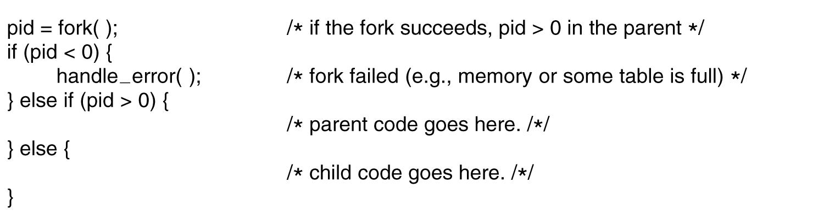
Processes in Linux
Figure 10-4. Process creation in Linux.
Tanenbaum, Modern Operating Systems 3 e, (c) 2008 Prentice-Hall, Inc. All rights reserved. 0-13-6006639

Slide 52
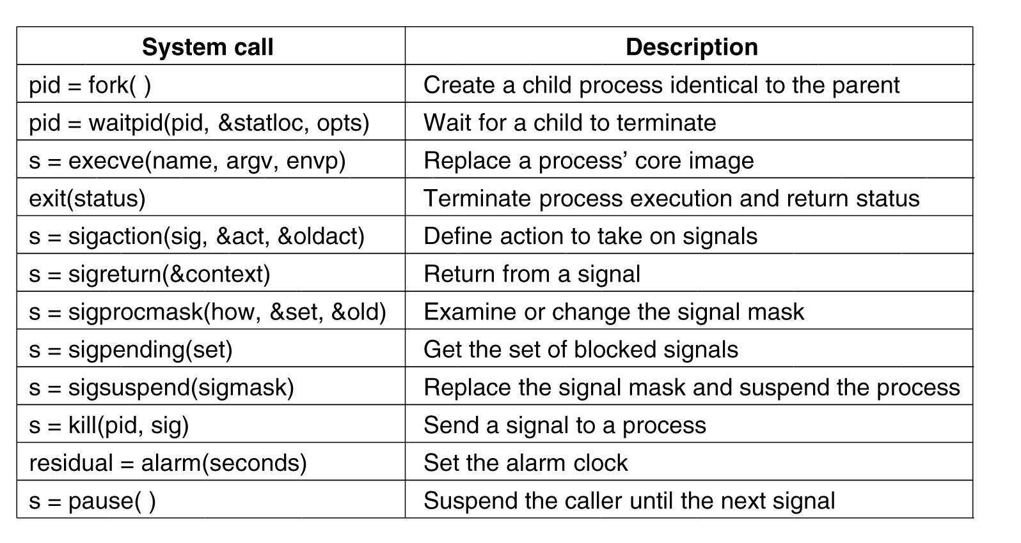
Process Management System Calls in Linux
Figure 10-6. Some system calls relating to processes.
Tanenbaum, Modern Operating Systems 3 e, (c) 2008 Prentice-Hall, Inc. All rights reserved. 0-13-6006639

Slide 53
Implementation of Processes and Threads
Categories of information in the process descriptor:
Scheduling parameters
Memory image
Signals
Machine registers System call state
File descriptor table
Accounting
Kernel stack
Miscellaneous
Tanenbaum, Modern Operating Systems 3 e, (c) 2008 Prentice-Hall, Inc. All rights reserved. 0-13-6006639

Slide 54
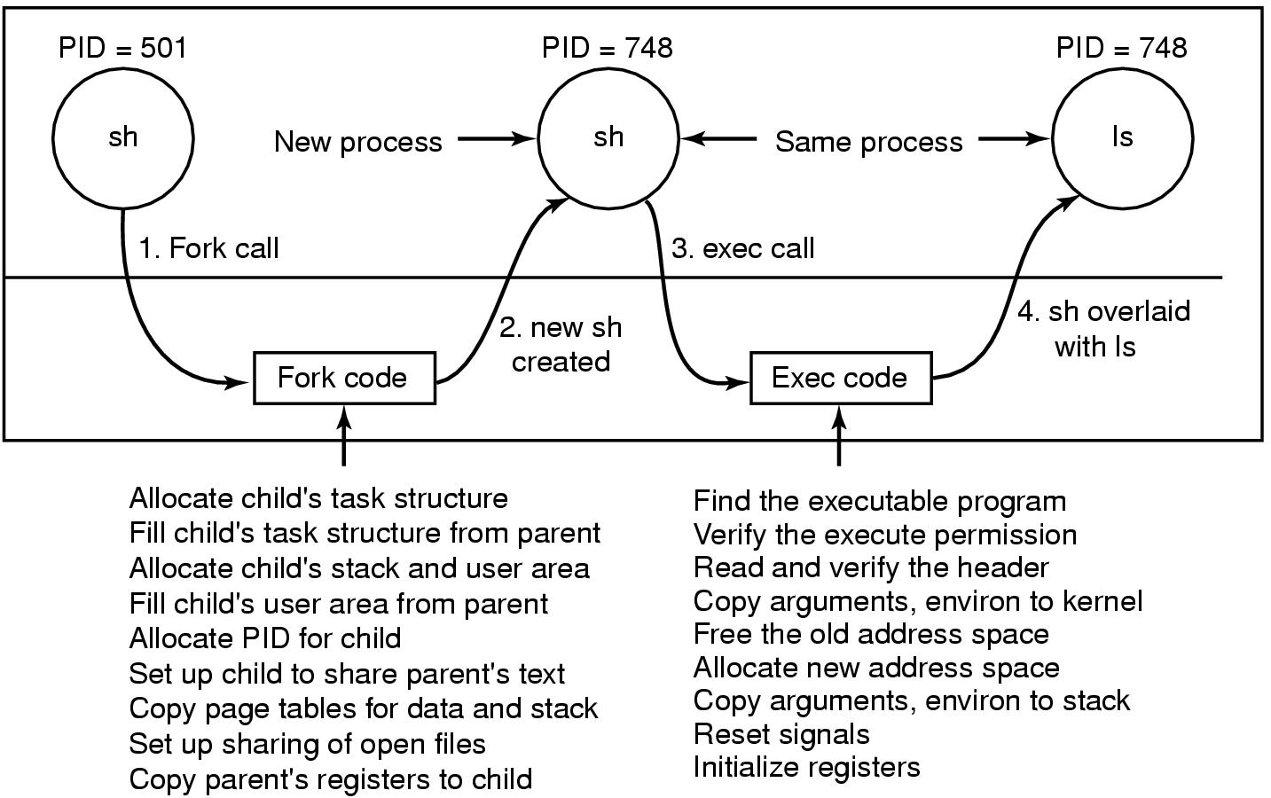
Implementation of Exec
Figure 10-8. The steps in executing the command ls typed to the shell.
Tanenbaum, Modern Operating Systems 3 e, (c) 2008 Prentice-Hall, Inc. All rights reserved. 0-13-6006639

Slide 55
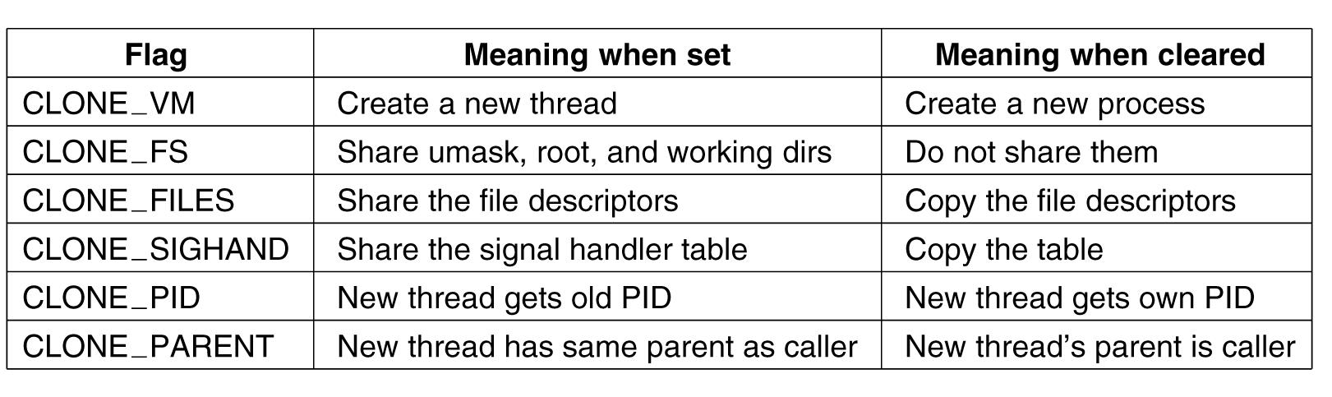
The Clone System Call
Figure 10-9. Bits in the sharing_flags bitmap.
Tanenbaum, Modern Operating Systems 3 e, (c) 2008 Prentice-Hall, Inc. All rights reserved. 0-13-6006639

Slide 56
The futex System Call
The futex() system call provides a method for a program to wait for a value at a given address to change, and a method to wake up anyone waiting on a particular address (while the addresses for the same memory in separate processes may not be equal, the kernel maps them internally so the same memory mapped in different locations will correspond for futex() calls). This system call is typically used to implement the contended case of a lock in shared memory, as described in futex(7).
When a futex(7) operation did not finish uncontended in userspace, a call needs to be made to the kernel to arbitrate. Arbitration can either mean putting the calling process to sleep or, conversely, waking a waiting process.
Source: futex(2) man page

Slide 57
2000s: NT-based Windows (2)
Figure 11-3. The Win32 API allows programs to run on almost all versions of Windows.
Tanenbaum, Modern Operating Systems 3 e, (c) 2008 Prentice-Hall, Inc. All rights reserved. 0-13-6006639

Slide 58
Programming Windows Vista
Figure 11-6. The programming layers in Windows.
Tanenbaum, Modern Operating Systems 3 e, (c) 2008 Prentice-Hall, Inc. All rights reserved. 0-13-6006639

Slide 59
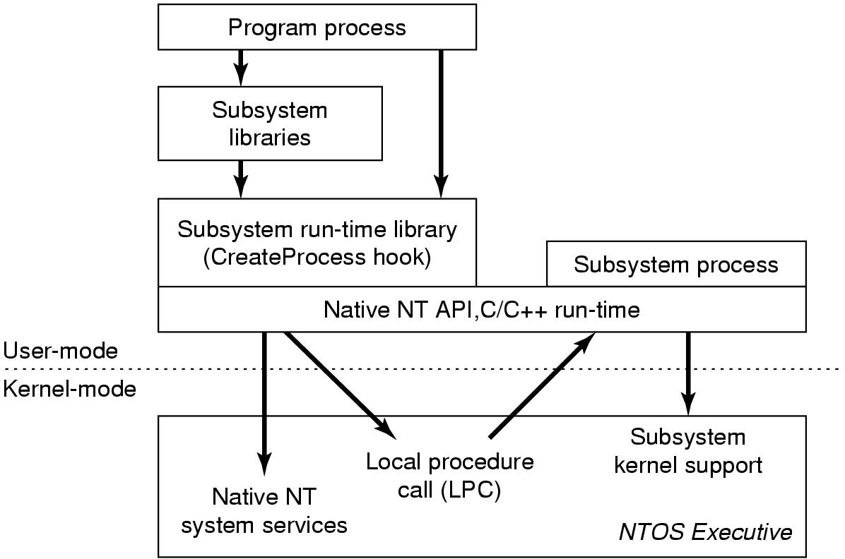
Programming Windows Vista (2)
Figure 11-7. The components used to build NT subsystems.
Tanenbaum, Modern Operating Systems 3 e, (c) 2008 Prentice-Hall, Inc. All rights reserved. 0-13-6006639

Slide 60
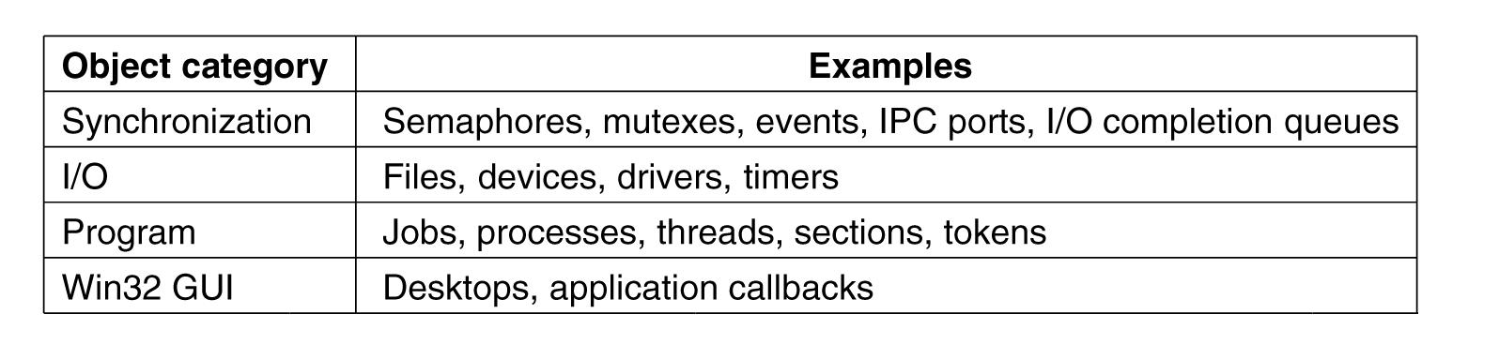
The Native NT Application Programming Interface (1)
Figure 11-8. Common categories of kernel-mode object types.
Tanenbaum, Modern Operating Systems 3 e, (c) 2008 Prentice-Hall, Inc. All rights reserved. 0-13-6006639

Slide 61
The Native NT Application Programming Interface (2)
Figure 11-9. Examples of native NT API calls that use handles to manipulate objects across process boundaries.
Tanenbaum, Modern Operating Systems 3 e, (c) 2008 Prentice-Hall, Inc. All rights reserved. 0-13-6006639

Slide 62
Operating System Structure
Figure 11-13. Windows kernel-mode organization.
Tanenbaum, Modern Operating Systems 3 e, (c) 2008 Prentice-Hall, Inc. All rights reserved. 0-13-6006639

Slide 63
The Kernel Layer
Figure 11-14. Some of the hardware functions the HAL manages.
Tanenbaum, Modern Operating Systems 3 e, (c) 2008 Prentice-Hall, Inc. All rights reserved. 0-13-6006639

Slide 64
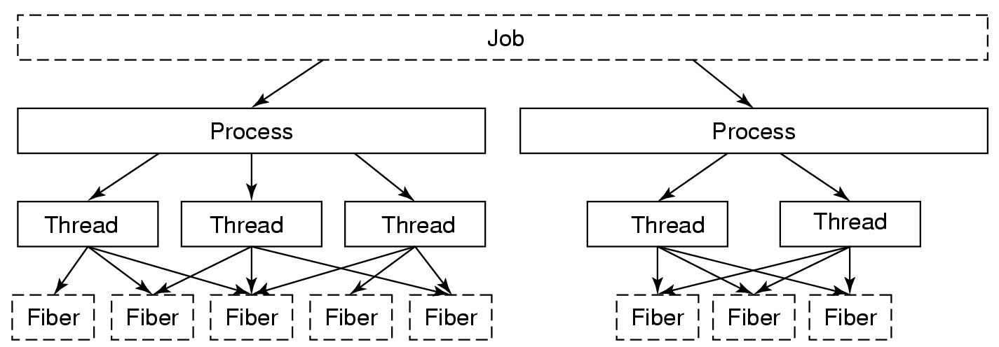
Processes and Threads in Windows Vista (1)
Figure 11-24. The relationship between jobs, processes, threads and fibers. Jobs and fibers are optional; not all processes are in jobs or contain fibers.
Tanenbaum, Modern Operating Systems 3 e, (c) 2008 Prentice-Hall, Inc. All rights reserved. 0-13-6006639

Slide 65
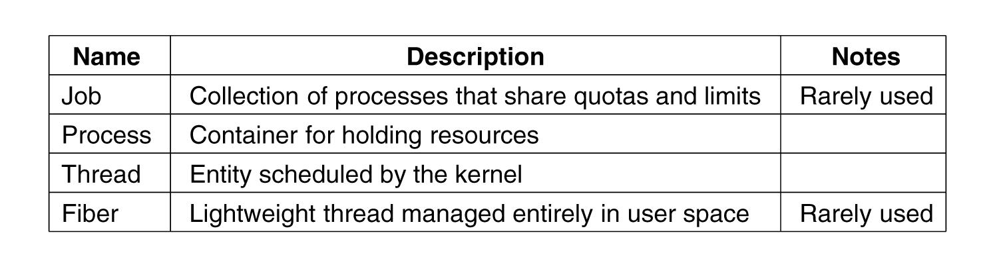
Processes and Threads in Windows Vista (2)
Figure 11-25. Basic concepts used for CPU and resource management.
Tanenbaum, Modern Operating Systems 3 e, (c) 2008 Prentice-Hall, Inc. All rights reserved. 0-13-6006639

Slide 66
Job, Process, Thread, and Fiber Management API Calls (1)
Actual search path for finding program to execute buried in library code for Win32, but managed more explicitly in UNIX.
Current working directory is kernel-mode concept in UNIX but user-mode string in Windows.
UNIX parses command line and passes an array of parameters, Win32 leaves argument parsing up to individual program.
Whether file descriptors can be inherited in UNIX is property of handle. In Windows it is property of both handle and parameter to process creation.
Win32 is GUI-oriented, new processes directly passed information about their primary window
Tanenbaum, Modern Operating Systems 3 e, (c) 2008 Prentice-Hall, Inc. All rights reserved. 0-13-6006639

Slide 67
Job, Process, Thread, and Fiber Management API Calls (2)
Windows has no SETUID bit as property of executable, one process can create a process that runs as a different user, as long as it can obtain a token with that user’s credentials.
Process and thread handle returned from Windows can be used to modify the new process/thread in many substantive ways. UNIX just makes modifications to new process between fork and exec calls.
Tanenbaum, Modern Operating Systems 3 e, (c) 2008 Prentice-Hall, Inc. All rights reserved. 0-13-6006639

Slide 68
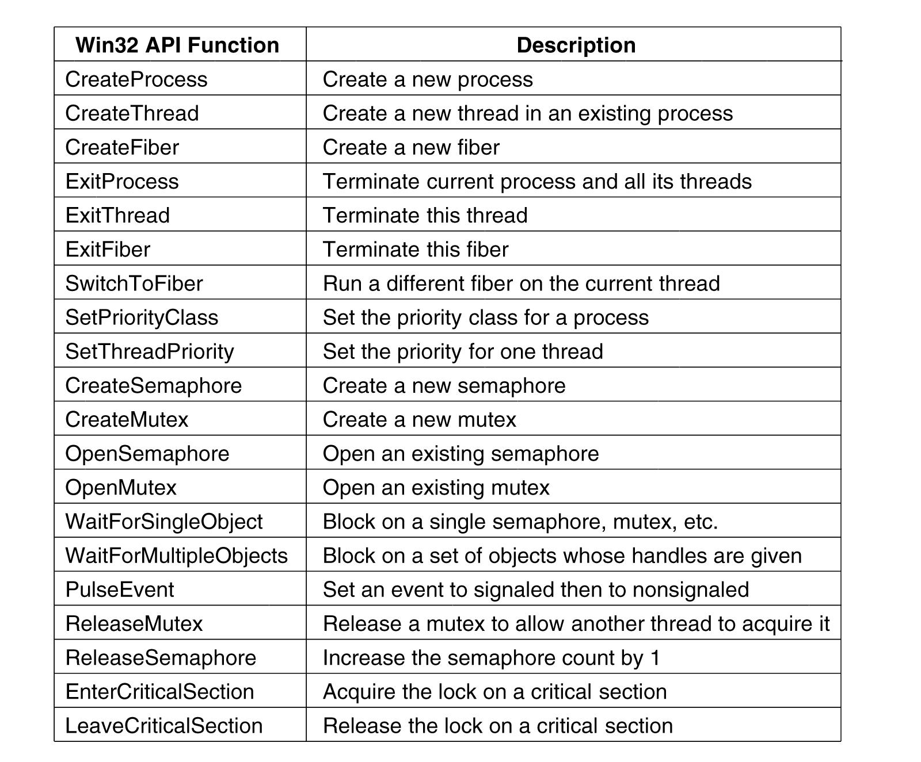
Synchronization
Figure 11-26. Some of the Win32 calls for managing processes, threads, and fibers.
Tanenbaum, Modern Operating Systems 3 e, (c) 2008 Prentice-Hall, Inc. All rights reserved. 0-13-6006639

Slide 69
Outline (reverse order)
Programming languages
Java
Python
JavaScript
Thread libraries
Pthreads
OpenMP
Operating system threads
Design choices
Linux
Windows
Hardware support
Simultaneous multi-threading

Slide 70
POSIX Threads (Pthreads)
Threadig for C/C++ programmers
Standardized thread programming interface
Low-level operations
De-facto standard on Linux
Implemented on top of OS system calls
Available as C library
Usage: gcc –lpthread foo.c

Slide 71
Thread Model
One process can have multiple threads
A thread has a private stack and can also have private global variables (explicitly declared)
All threads created within a process share address space, file handlers, etc…
Pthreads are implemented as Linux kernel-level threads

Slide 72
Pthread API
Can be divded into four major groups:
Thread management :
pthread_create, pthread_detach, pthread_join, pthread_self, …
Mutexes:
pthread_mutex_lock, pthread_mutex_unlock, pthread_mutex_init, pthread_mutex_trylock, …
Condition variables:
pthread_cond_wait, pthread_cond_signal, pthread_cond_broadcast, pthread_cond_init, pthread_cond_destroy, …
Synchronization
pthread_barrier, …
pthread_rwlock, …

Slide 73
Pthread Code Example
thread examples\pthread_example.c
From: https://computing.llnl.gov/tutorials/pthreads/

Slide 74
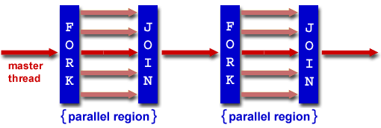
OpenMP
API for shared-memory programming in C/C++ and Fortran
Often used in high-performance computing (supercomputing)
Portable code
Also used by automatic parallelizing compilers
gcc 4.7 supports OpenMP 3.1
gcc -ftree-parallelize-loops foo.c
OpenMP threads maps to kernel threads
Fork-join programming model
Figure from: https://computing.llnl.gov/tutorials/openMP/

Slide 75
Data sharing attribute clauses
shared: the data within a parallel region is shared, which means visible and accessible by all threads simultaneously.
private: the data within a parallel region is private to each thread, which means each thread will have a local copy and use it as a temporary variable.
default: allows the programmer to state that the default data scoping within a parallel region will be either shared, none, firstprivate, or private
firstprivate: like private except initialized to original value.
lastprivate: like private except original value is updated after construct.
reduction: a safe way of joining work from all threads after construct.
Text from: http://en.wikipedia.org/wiki/OpenMP

Slide 76
Synchronization clauses
critical: the enclosed code block will be executed by only one thread at a time, and not simultaneously executed by multiple threads.
atomic: the memory update (write, or read-modify-write) in the next instruction will be performed atomically. It does not make the entire statement atomic; only the memory update is atomic.
ordered: the structured block is executed in the order in which iterations would be executed in a sequential loop
barrier: each thread waits until all of the other threads of a team have reached this point.
nowait: specifies that threads completing assigned work can proceed without waiting for all threads in the team to finish.
Text from: http://en.wikipedia.org/wiki/OpenMP

Slide 77
Scheduling clauses
schedule(type, chunk): This is useful if the work sharing construct is a do-loop or for-loop. The iteration(s) in the work sharing construct are assigned to threads according to the scheduling method defined by this clause. The three types of scheduling are:
static: The iterations are divided among threads equally by default.
dynamic: The iterations are allocated to a smaller number of threads. Once a particular thread finishes its allocated iteration, it returns to get another one from the iterations that are left.
guided: A large chunk of contiguous iterations are allocated to each thread dynamically (as above).
Based on text from: http://en.wikipedia.org/wiki/OpenMP

Slide 78
OpenMP Hello World Example
thread examples\openmp_helloworld.c
Example from: https://computing.llnl.gov/tutorials/openMP/

Slide 79
Outline (reverse order)
Programming languages
Python
Java
HTML5 (JavaScript)
Thread libraries
Pthreads
OpenMP
Operating system threads
Design choices
Linux
Windows
Hardware support
Simultaneous multi-threading

Slide 80
Python
Provided by threading and thread module
Thread module implemented using Pthreads in Linux
This is a low-level module typically not used by application programmers
Threading module builds on thread module:
But be aware of the Global Interpreter Lock!
An alternative multiprocessing interface for “threading using processes”
Another alternative: c extension modules
Inspired by Java Threading
But synchronization is explicit!
Python thread operations map well to Pthread operations
Thread management: Thread objects
Mutex: Lock objects (and RLock objects)
Condition variables: Condition objects
Other synchronization: Semaphore objects, Event objects,

Slide 81
Python Exampe
thread examples\python_example.py
Example from: http://docs.python.org/tutorial

Slide 82
Java
Threading is deeply integrated in the language
Implicit synchronization
Collection data structures are thread safe
Concurrency optimized data structures
May make it hard to understand performance
Threads are represented by objects that implement the Runnable interface
Used similarly to Python example in previous slide
Implicit synchronization:
Implemented as monitor
Example: thread examples\java_syncronized.java
Source: http://docs.oracle.com/javase/tutorial/essential/concurrency/
Note! Design is broken; do not use it

Slide 83
Java High Level Concurrency Objects
Locks package:
Mutex/lock
Condition variable
Read/write lock
Concurrent collections:
Blocking queue
ConcurrentMap (multiple-readers)
Executors:
Thread pools
Fork/join (similar to OpenMP)
Atomic variables
Example: C:\Users\larsab\workspace\DistributedSpell\src\edu\princeton\function\distspell\SearchWorkerThread.java (code not publically available)

Slide 84
HTML5 JavaScript
HTML5 is a language for presenting and structuring WWW content
Includes JavaScript
JavaScript:
Scripting language for web applications
Code runs in web-browser
Typically used to implement GUI that communicates with application logic run on server side
HTML5 introduces many new features to make JavaScript more powerful:
Multi-threading
GPU support, canvas…

Slide 85
JavaScript Web Worker Threads
JavaScript is single-threaded event based programming model
A single thread handles events
Events: mouse-clicks, keyboard press, etc…
Remote procedure calls are asynchronous
Send request
Continue with other work
Receive event when procedure call returns
Web Worker:
An API for running scripts in the background independently of any user interface scripts.
Avoid blocking GUI for computation or I/O intensive work
Web Worker programming model:
Create new worker thread
Worker thread posts results to GUI thread
GUI thread handles event

Slide 86
JavaScript Example: HTML page
<!DOCTYPE HTML> <title>Shared workers: demo 2</title> <pre id="log">Log:</pre> <script> var worker = new SharedWorker('test.js'); var log = document.getElementById('log'); worker.port.addEventListener('message', function(e) { log.textContent += '\n' + e.data; }, false); worker.port.start(); // note: need this when using addEventListener worker.port.postMessage('ping'); </script>

Slide 87
JavaScript Example: JavaScript
onconnect = function(e) { var port = e.ports[0]; port.postMessage('Hello World!'); port.onmessage = function(e) { port.postMessage('pong'); }
}

Slide 88
Summary
Multi-threading in hardware to utilize processor core resources
Hardware provides simple primitives for implementing thread-packages
Kernel-level vs. user-level thread packages
Linux and Windows kernel-level thread package
System calls for implementing thread-packages
Pthreads: low-level thread programming in C/C++
OpenMP: automated threading
Python: low-level thread programming in Python
Java: language support for threading
JavaScript: threading to avoid blocking GUI

Slide 89
Learn more
Deterministic execution was hot research topic
Dthreads
Automated race detection was hot research topic
RacerX
Automated parallelization has been promising approach for the last 30 years
Parallel Fortran
Lot of work to improve process creation and IPC
Thread vs. processes performance assumptions still true?

